Slide 1

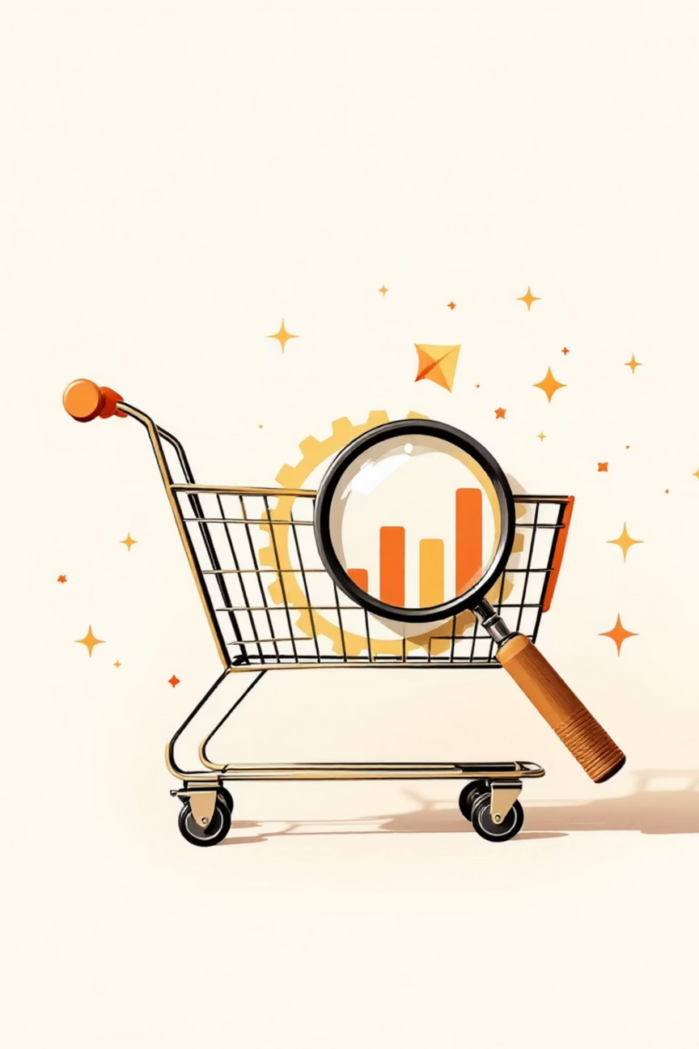

Customer Shopping Behavior Analysis
Analyzing 3,900 purchases to uncover spending patterns, customer segments, and product preferences.
Notes:
1

Slide 2

Project Overview
1
2
Data-Driven Insights
Strategic Decisions
Uncover spending patterns and customer segments.
Guide business decisions with product and subscription insights.
3
Optimize Operations
Improve efficiency and reduce costs through data.
Notes:
2

Slide 3

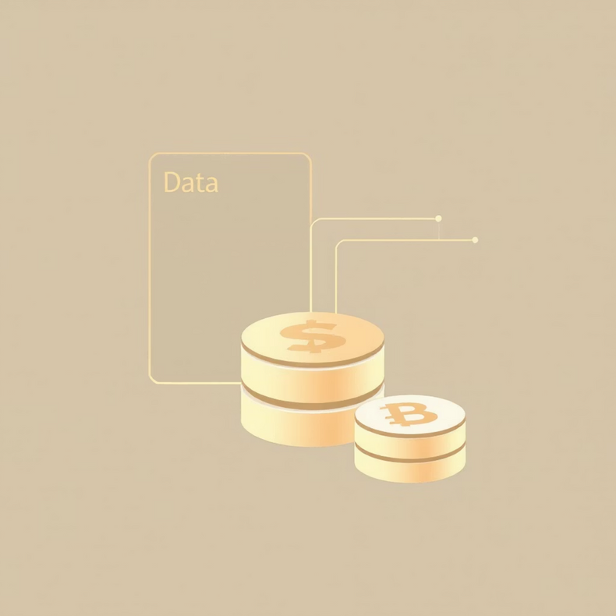
Dataset Summary
Key Features
Data Snapshot
Customer demographics (Age, Gender, Location, Subscription)
3,900 Rows, 18 Columns
37 missing values in Review Rating
Purchase details (Item, Category, Amount, Season, Size, Color)
Shopping behavior (Discount, Promo, Previous Purchases, Frequency, Review, Shipping)
Notes:
3

Slide 4

Exploratory Data Analysis (Python)
01
Data Loading & Initial Exploration
Imported with pandas, checked structure and summary statistics.
02
Missing Data Handling
Imputed Review Rating using median per category.
03
Column Standardization & Feature Engineering
Renamed to snake_case, created age_group and purchase_frequency_days.
04
Data Consistency & Integration
Dropped redundant promo_code_used, loaded to PostgreSQL.
Notes:
4

Slide 5

Data Analysis (SQL)
Key business questions answered through structured SQL analysis.
Revenue by Gender
High-Spending Discount Users
Top 5 Products by Rating
Female: $75,191 | Male: $157,890
Identified 839 customers.
Gloves (3.86), Sandals (3.84), Boots (3.82), Hat (3.80), Skirt (3.78)
Notes:
5

Slide 6
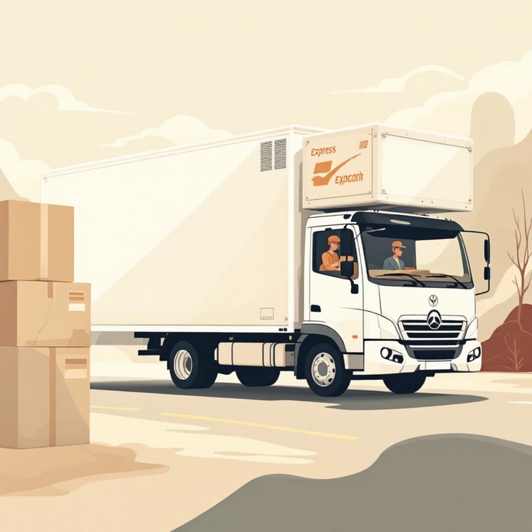

SQL Insights: Shipping & Subscriptions
Shipping Type Comparison
Subscribers vs. Non-Subscribers
Standard: $58.46 | Express: $60.48
Subscribers: 1053 customers, Avg Spend $59.49, Total Revenue $62,645
Non-Subscribers: 2847 customers, Avg Spend $59.87, Total Revenue $170,436
Notes:
6

Slide 7
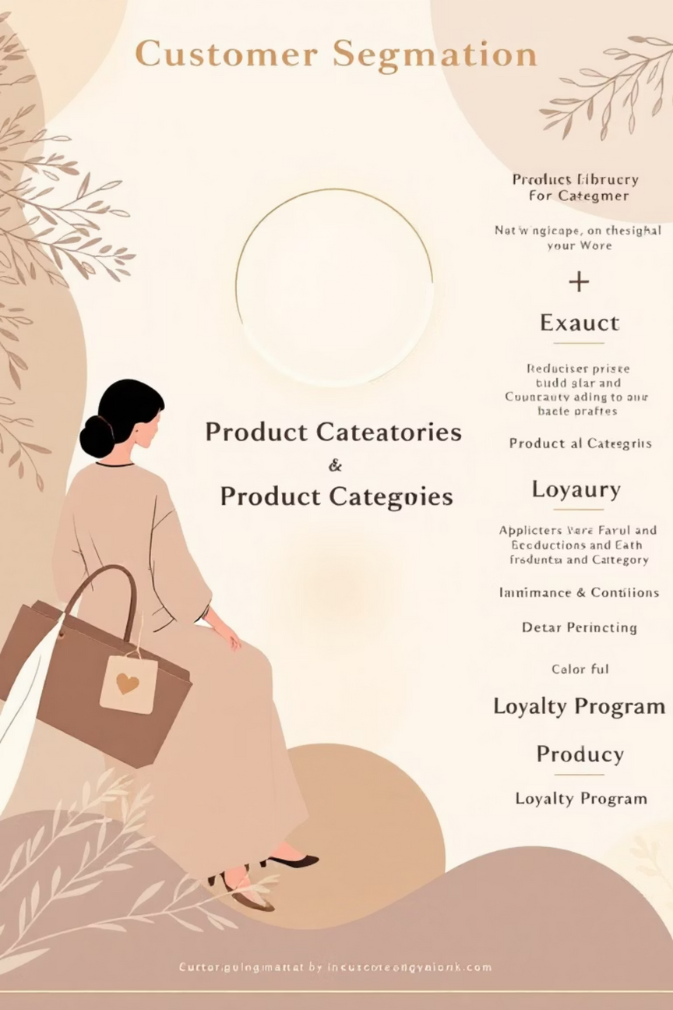
SQL Insights: Product & Customer Focus
Discount-Dependent Products
Customer Segmentation
Hat (50%), Sneakers (49.66%), Coat (49.07%), Sweater (48.17%), Pants (47.37%)
Loyal (3116), New (83), Returning (701)
Repeat Buyers & Subscriptions
958 repeat buyers are subscribers.
Notes:
7

Slide 8
Top Products by Category
1
Accessories
Jewelry
2
Clothing
Blouse
3
Footwear
Sandals
4
Outerwear
Jacket
Notes:
8

Slide 9
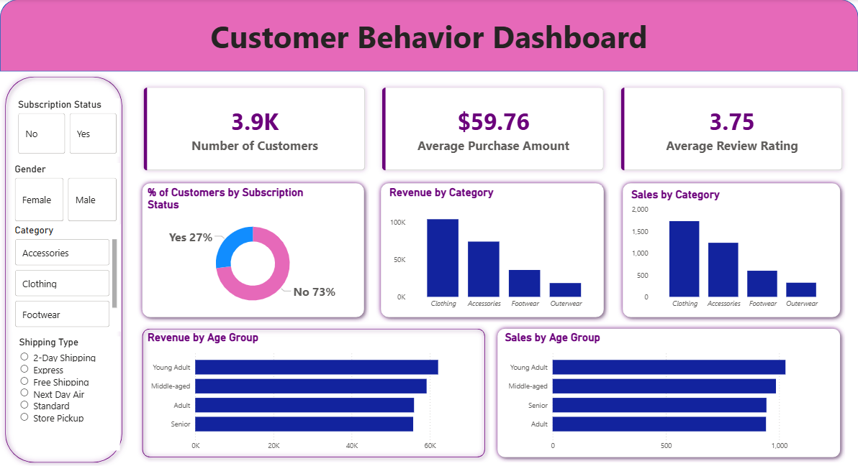
Power BI Dashboard
Avg. Review
Non-Subscribers
Notes:
9

Slide 10

Business Recommendations
Boost Subscriptions
Promote exclusive benefits.
Customer Loyalty Programs
Reward repeat buyers for "Loyal" segment.
Review Discount Policy
Balance sales with margin control.
Product Positioning
Highlight top-rated and best-selling items.
Targeted Marketing
Focus on high-revenue age groups and express shipping users.
Notes:
10

